Slide 1



PREMUP:
Manipulating prior strength to render different levels of PE
Notes:
<number>
Size 40 header; size 20 body
<number>

Slide 2
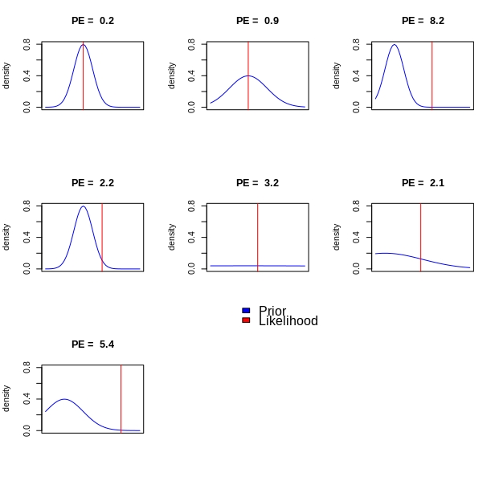
PREMUP: Manipulating prior strength to render different levels of PE
Strong prior
Weak prior
Flat prior
Notes:
<number>
<number>
<number>

Slide 3
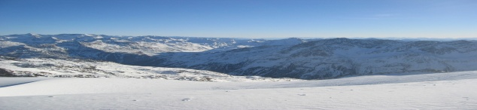



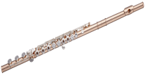
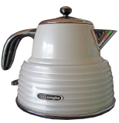
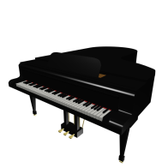

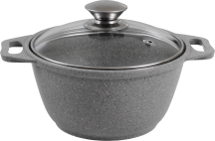
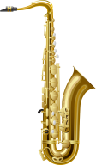


PREMUP: Manipulating prior strength to render different levels of PE
Instruments
Household objects
Instruments
Household objects
.90
.10
.90
.10
2s
.10
.90
.10
.90
3s
.50
.50
.70
.30
.50
.50
.30
.70
Household object
Vehicle
Strong vs Flat group
Strong vs Weak group
Notes:
<number>
<number>
<number>

Slide 4


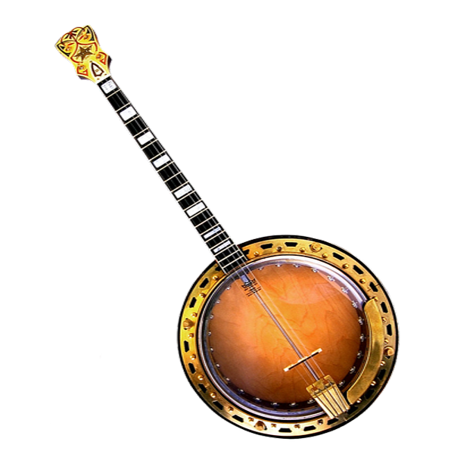


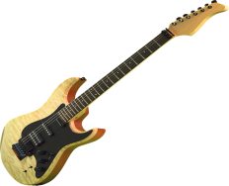
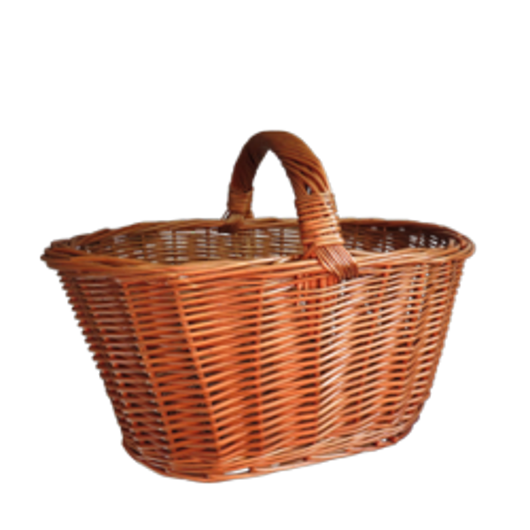

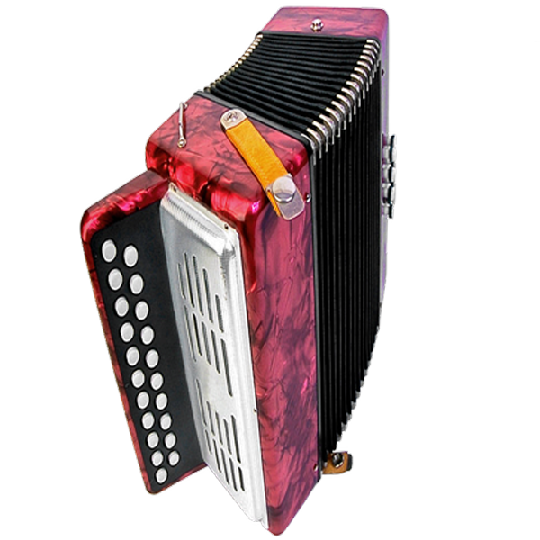
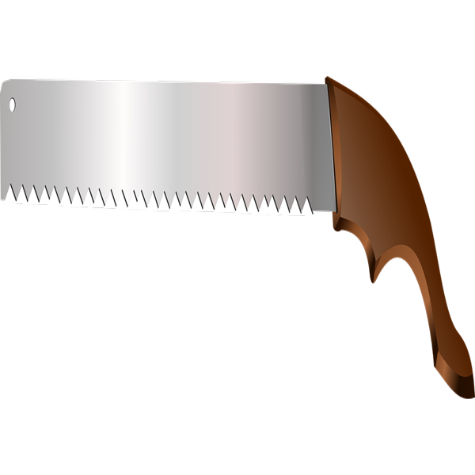

PREMUP: Manipulating prior strength to render different levels of PE
Phase1. Contingency learning.
“predict”
Phase2. Encoding
“categorize”
Phase3. Memory test
“recognize”
?
Have you seen this object before?
?
?
Notes:
<number>
<number>
<number>

Slide 5
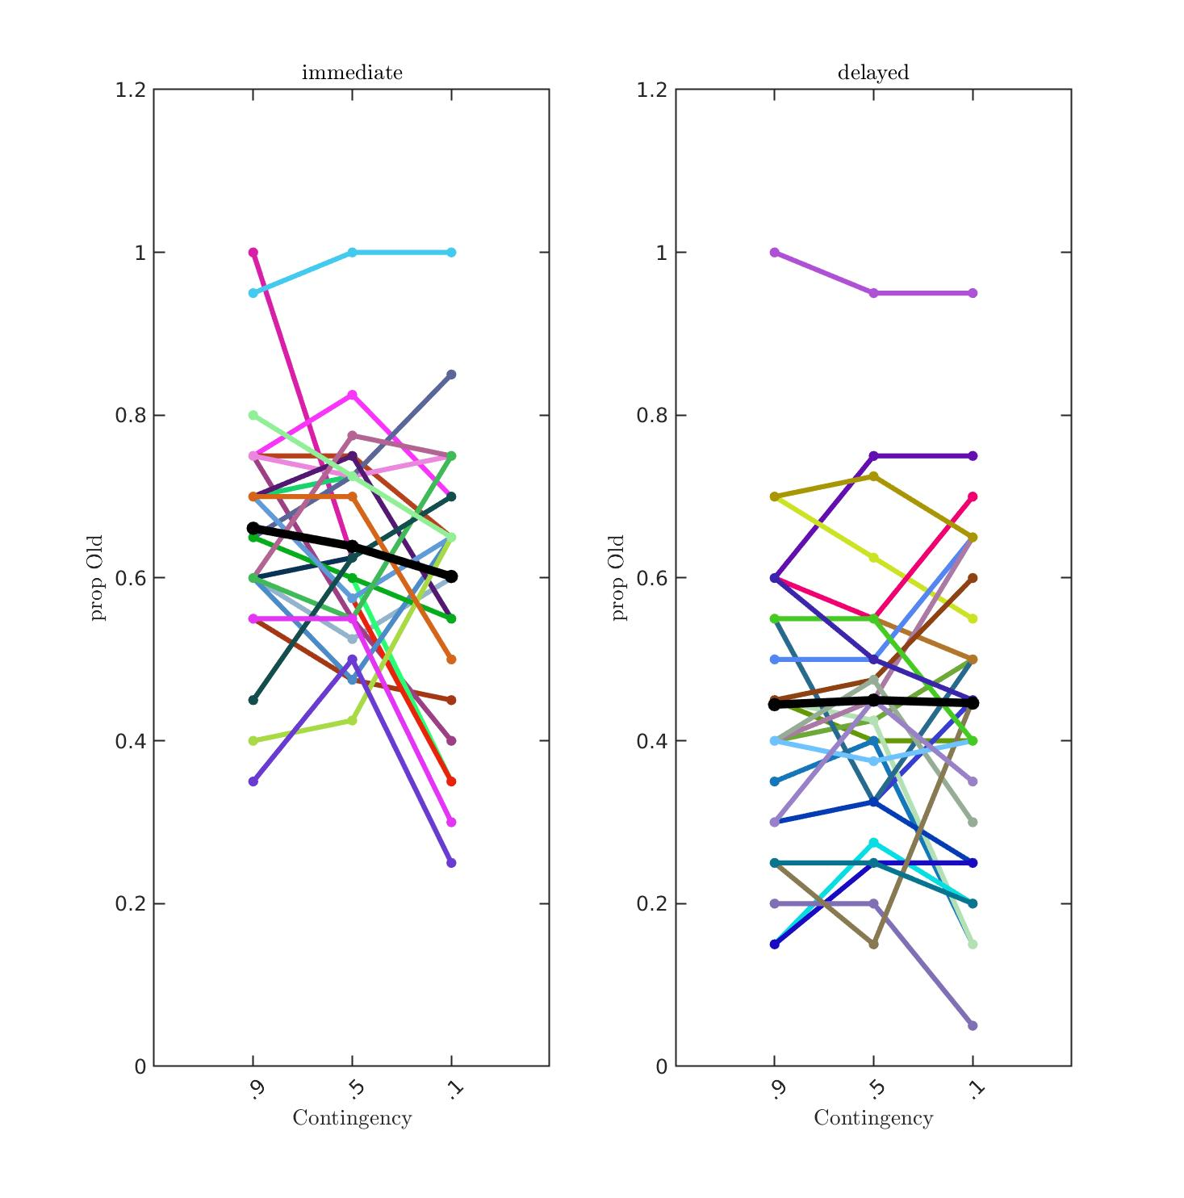
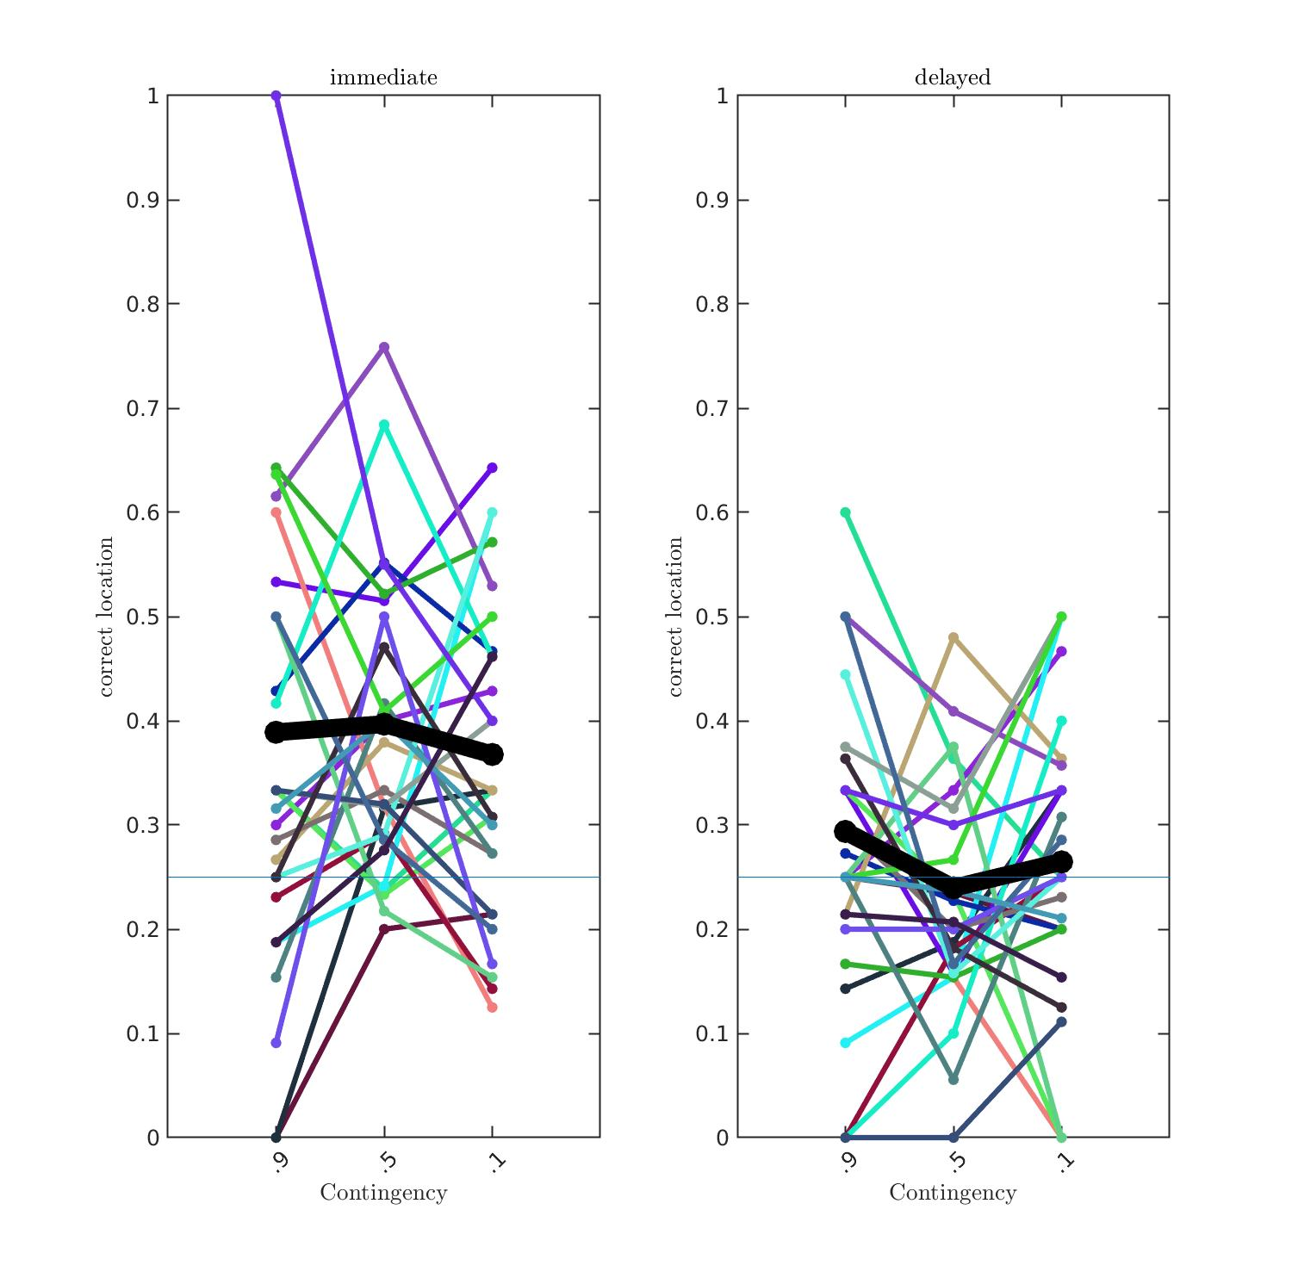
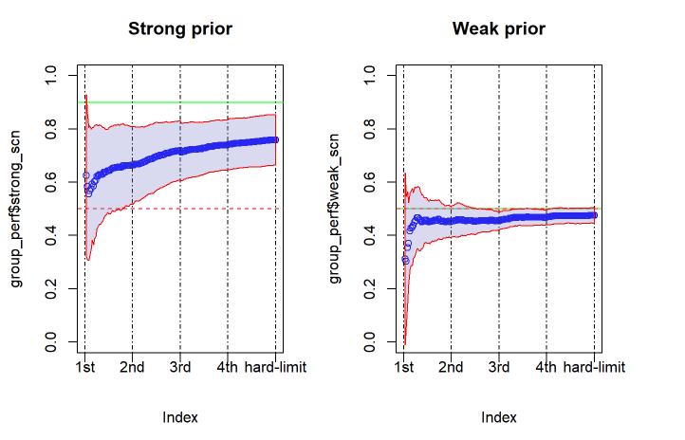
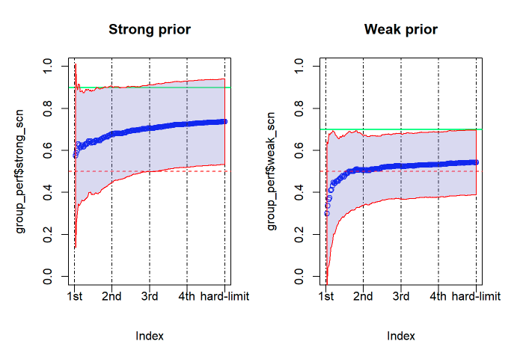
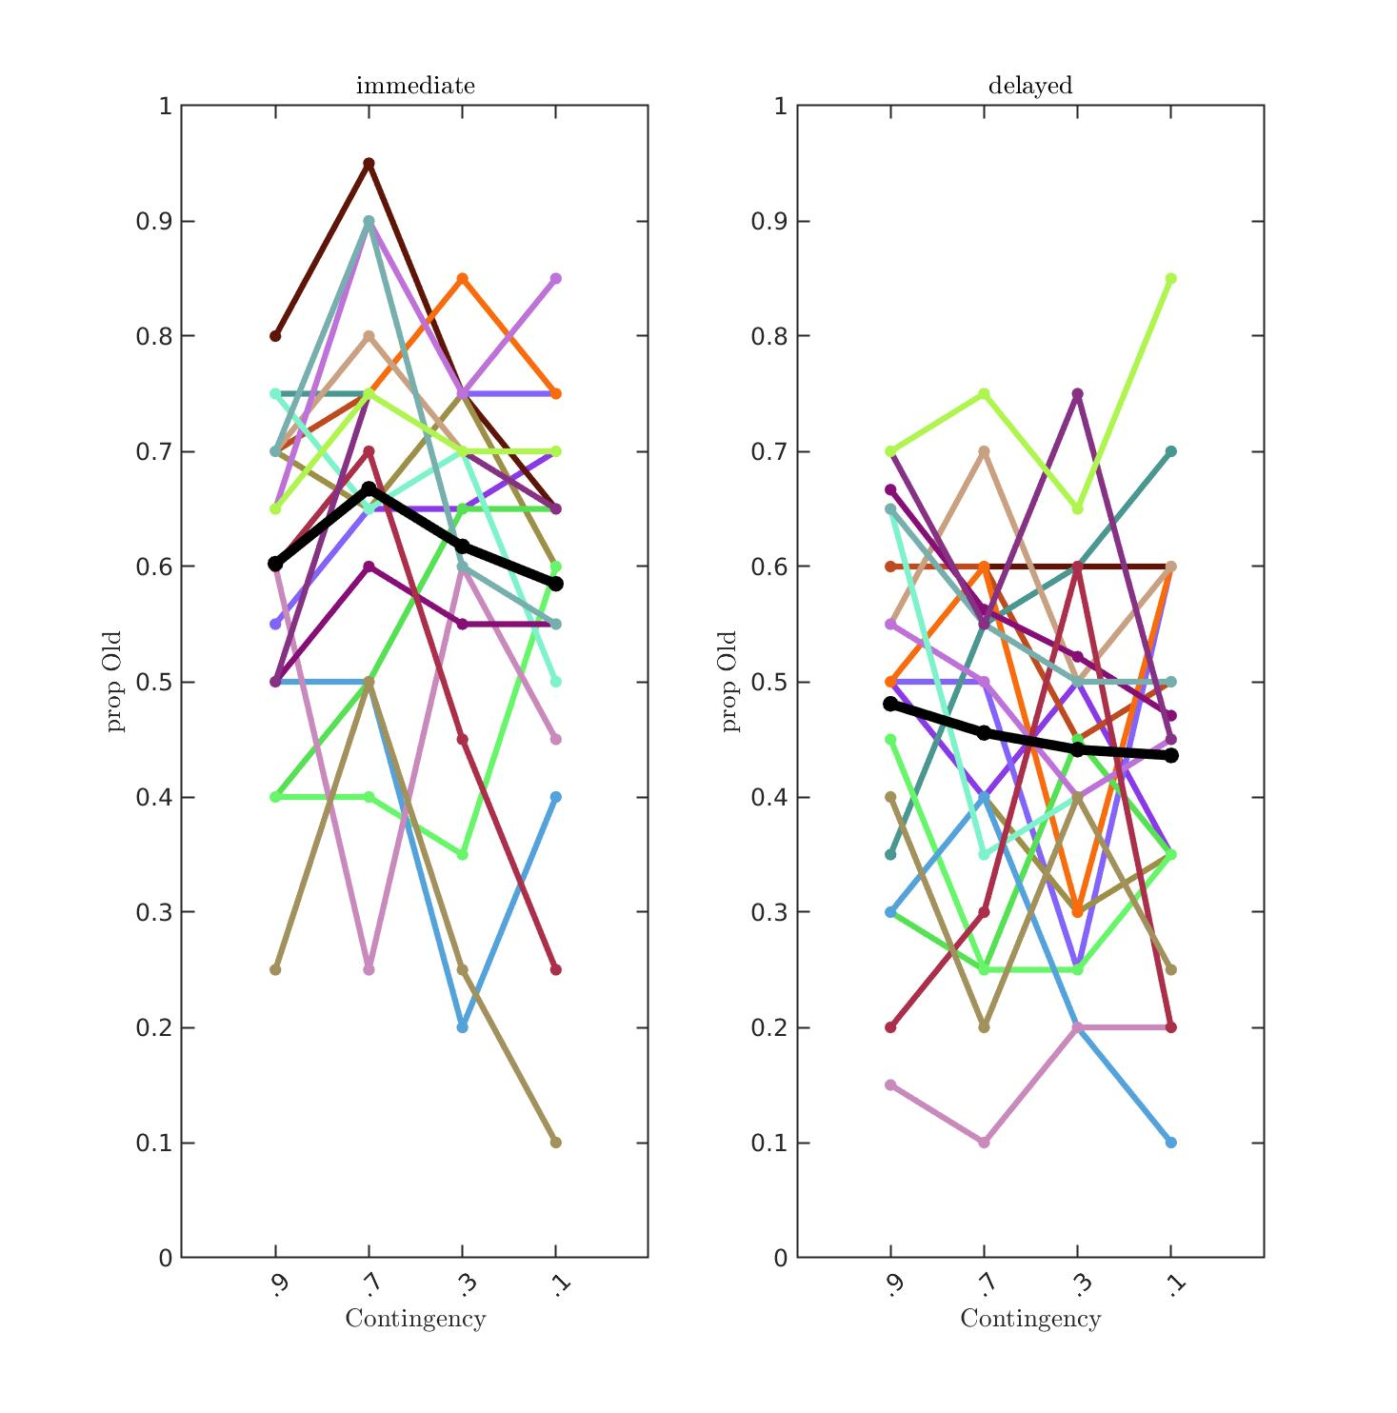
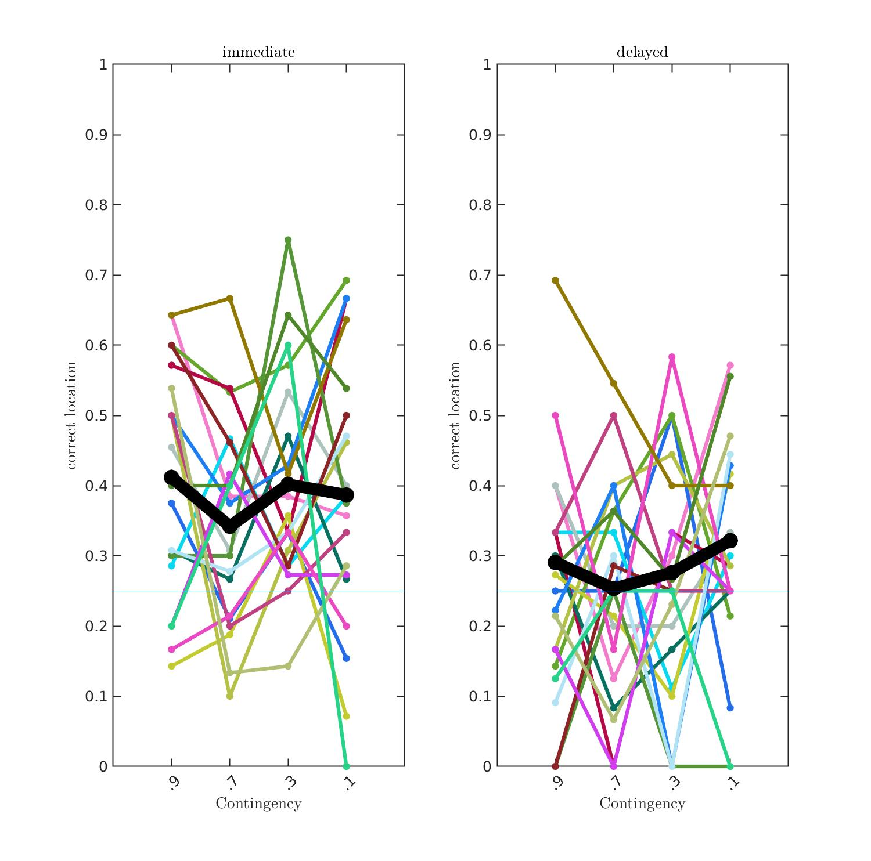
PREMUP: Manipulating prior strength to render different levels of PE
Phase1. Contingency learning
Phase3. Memory test
Strong
Flat
Strong
Weak
Notes:
<number>
<number>
<number>

Slide 6


PREMUP: Is there something special about a flat prior?
Change in priors
Quick reminder:
At the end of each block we measured the perceived object-scene contingency with a 0-100 rating scale.
In Phase 2, the contingencies were removed to 50-50 to avoid too many objects or the use of fillers.
How likely is to find each one of these categories in this context?
0 %
100 %
Music objects
Household objects
Notes:
<number>
<number>
<number>
<number>

Slide 7
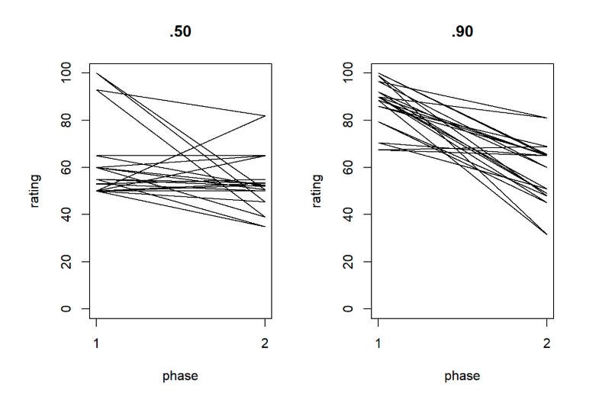
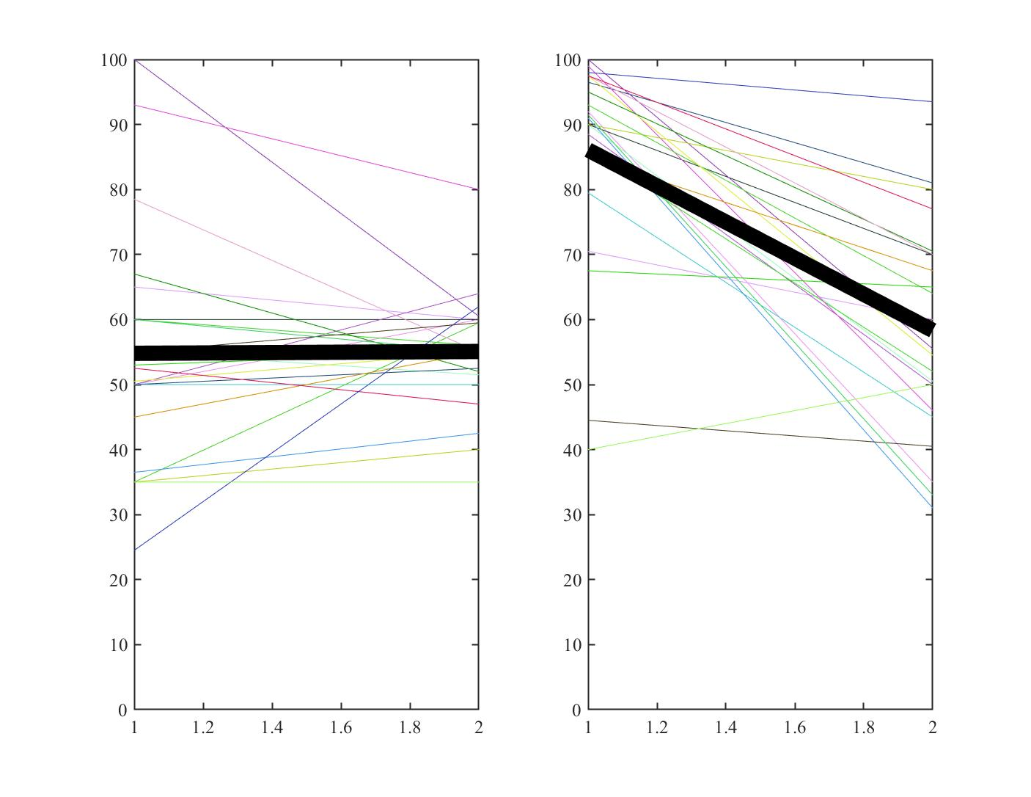
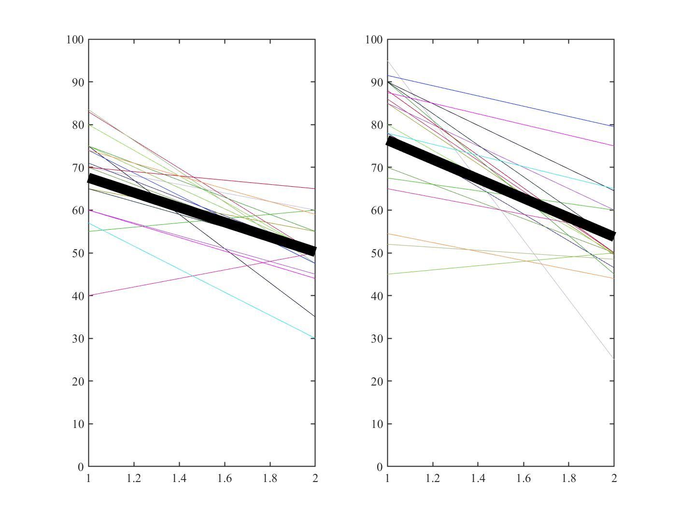
PREMUP: Is there something special about a flat prior?
.70
.90
Phase 1
Phase 2
Phase 1
Phase 2
Phase 1
Phase 2
Phase 1
Phase 2
Notes:
<number>
<number>
<number>
<number>

Slide 8
PREMUP: Where to now?
Notes:
<number>
<number>
<number>
<number>

Slide 9
PREMUP: Where to now?
- Keep contingencies on Phase 2.
- Keep prediction task on Phase 2
- Add phase1 reminder on Day 2.
Phase1. Contingency learning
Phase2. Encoding
Phase3. Memory test
?
?
Have you seen this object before?
?
?
?
?
Notes:
<number>
<number>
<number>

Slide 10
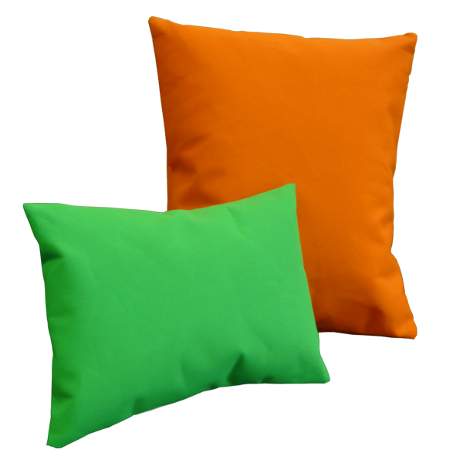
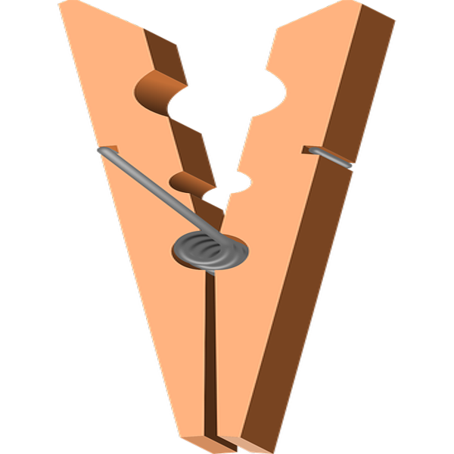

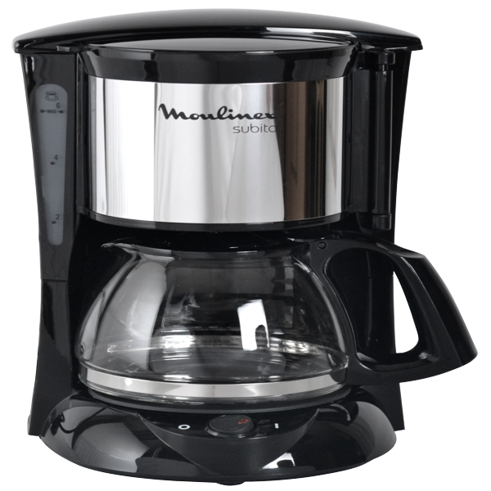
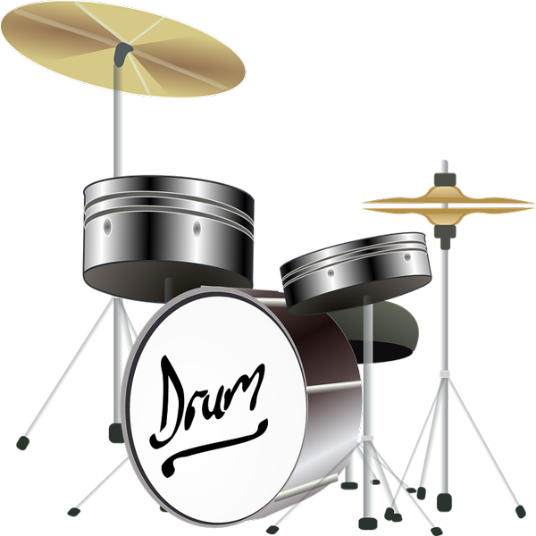
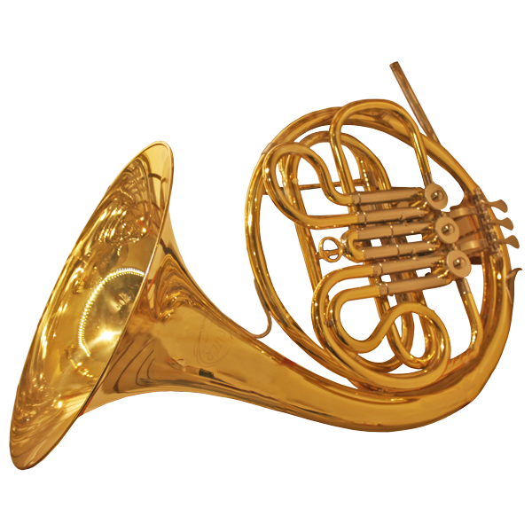
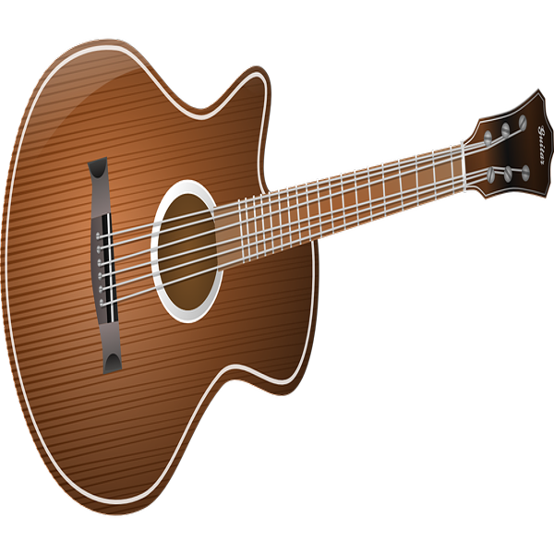
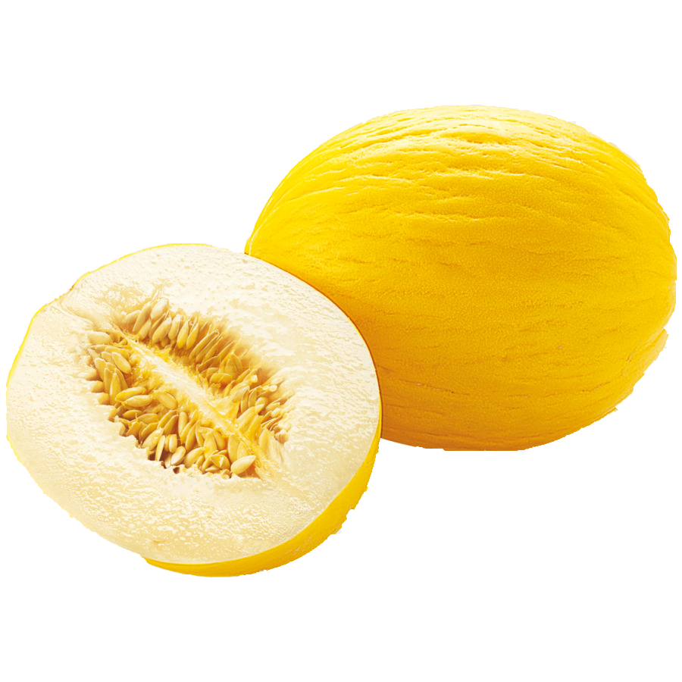
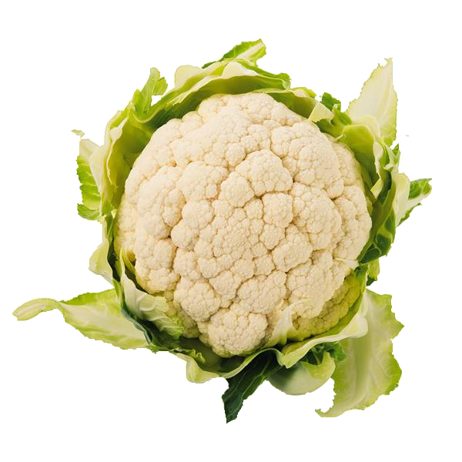
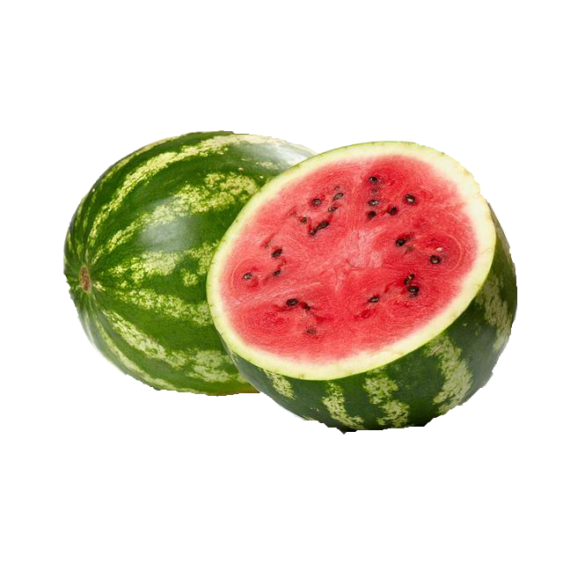

PREMUP: Conceptual setting
Likelihood of seeing a given object
Notes:
<number>
<number>
<number>
<number>

Slide 11
PREMUP: TWF (Thing With Franc*sco)
Tentative project names
or: Finally… Updating!
or: putting the “up” in PREMUP
or: SALEM (Statistical learning and episodic memory)
Notes:
<number>
<number>
<number>
<number>

Slide 12
PREMUP: TWF (Thing With Franc*sco)
What are PE used for? A logical argument.
Major premise: Our system uses pre-existing information (i.e., priors) to anticipate/explain away incoming evidence (predictions).
Minor premise: Learning and re-learning do happen.
Conclusion: Therefore, priors are updated.
Notes:
<number>
<number>
<number>
<number>

Slide 13
PREMUP: TWF (Thing With Franc*sco)
What are PE used for? A logical argument.
Major premise: Our system uses pre-existing information (i.e., priors) to anticipate/explain away incoming evidence (predictions).
Minor premise: Learning and re-learning do happen.
Conclusion: Therefore, priors are updated.
Some definitions:
Prior updating = integration of new information into existing knowledge.
Prediction errors = pieces of information that do not match the system’s priors.
Hypothesis: Our system uses PE to update priors.
Notes:
<number>
<number>
<number>
<number>

Slide 14
PREMUP: TWF (Thing With Franc*sco)
What are PE used for?
Notes:
<number>
<number>
<number>
<number>

Slide 15
PREMUP: TWF (Thing With Franc*sco)
What are PE used for?
?
Notes:
<number>
<number>
<number>
<number>

Slide 16
PREMUP: TWF (Thing With Franc*sco)
What are PE used for?
?
?
Notes:
<number>
<number>
<number>
<number>

Slide 17
PREMUP: TWF (Thing With Franc*sco)
What are PE used for?
But.. how can we measure priors?
- Cumulative accuracy? Meh. Difficult to map to a cognitive process.
- Probability distribution of responses? Too many observations.
- Modeling neural data? Difficult to interpret.
- Categorical predictions? Almost!
?
Notes:
<number>
<number>
<number>
<number>

Slide 18
PREMUP: TWF (Thing With Franc*sco)
What are PE used for?
But.. how can we measure priors?
- Cumulative accuracy? Meh. Difficult to map to a cognitive process.
- Probability distribution of responses? Too many observations.
- Modeling neural data? Difficult to interpret.
- Categorical predictions? Almost! But implies prior collapsing.
?
Notes:
<number>
<number>
<number>
<number>

Slide 19
PREMUP: TWF (Thing With Franc*sco)
Back to explicit reports!
Caveats:
- We (I) don’t like them.
- It is not granted that they reflect the true
underlying knowledge structure.
- People are bad at estimating proportions
- People are really bad at estimating likelihoods.
How likely is to find each one of these
categories in this context?
0 %
100 %
Instruments
Household object
Notes:
<number>
<number>
<number>

Slide 20
PREMUP: TWF (Thing With Franc*sco)
Back to explicit reports!
Pros:
- They give us a continuous measure.
- They require few assumptions.
- They are allow for a reasonable number of trials.
- They are compatible with an episodic memory test.
- They might be the “best” (as in less bad)
Approximation to the underlying knowledge
structure.
How likely is to find each one of these
categories in this context?
0 %
100 %
Instruments
Household object
Notes:
<number>
<number>
<number>

Slide 21
PREMUP: TWF (Thing With Franc*sco)
Short practice
Encoding
Phase3. Memory test
Have you seen this object before?
Notes:
<number>
<number>
<number>

Slide 22
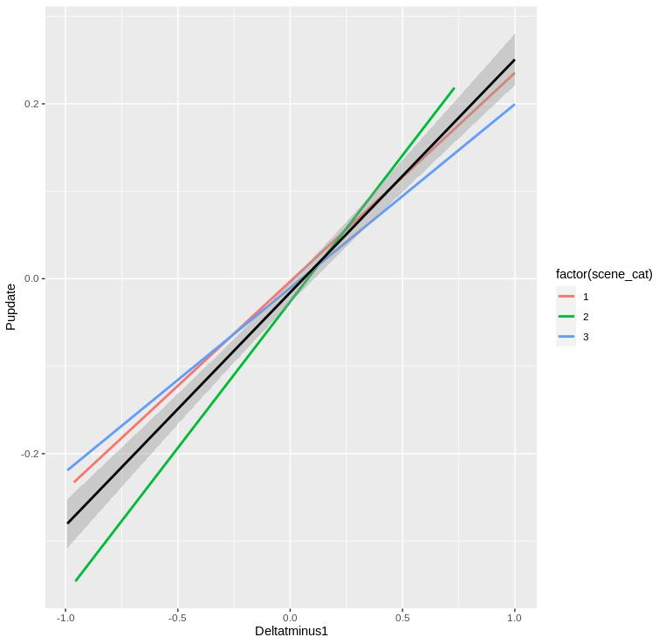
PREMUP: TWF (Thing With Franc*sco)
Simulations
Trial-by-trial computation of PE: The relationship between PE and statistical learning can be quantified with the use of a reinforcement learning model. In this model, PE error is used to update the expected values of each scene-object association, which are in turn transformed into prior probabilities.
Notes:
<number>
<number>
<number>

Slide 23
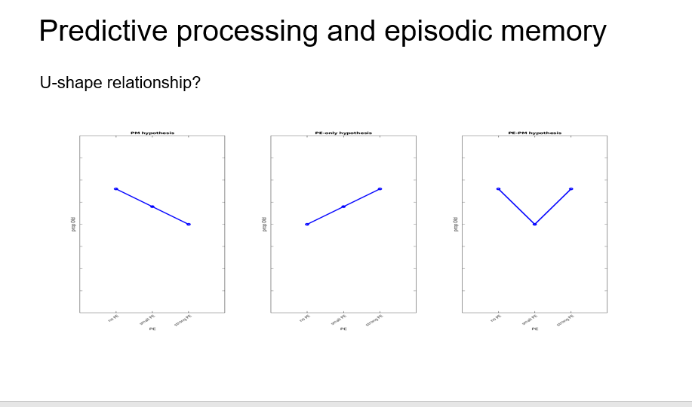
PREMUP: TWF (Thing With Franc*sco)
U-shape relationship?
Notes:
<number>
<number>
<number>

